Slide 1


Real Estate Pricing
& Demographic
Shifts
Database Design and Implementation
JUNE 2019
Daniel Cook, Stephen Ronkowski, , S M Nazarat Hossain, Jessie Hung
University of Chicago MScA
Data Engineering Platforms

Slide 2
PRESENTATION AGENDA
Executive Summary
Reporting
Business Use Case
Tableau and R
Research Objectives
Challenges, Conclusions,
& Recommendations
Goals and analysis needs
Lessons, learnings, and ramblings
Methodology
& Tools Considerations
References
ETL, models, and choices
Where to find the data we used

Slide 3

EXECUTIVE SUMMARY
Combine historical census data, including median income and population growth, with mortgage rates and housing sales data to forecast future real estate prices within a given geographic area.
University of Chicago MScA JUNE 2019

Slide 4

BUSINESS USE CASE
Real estate companies can use this data to target markets for acquisitions, renovations, etc.
Buyers can use this model to get a sense of past, current, and future market state in a given geographic area.
Companies can use data to locate areas for current and future physical storefront construction in a market matching or trending towards ideal customer demographic profile(s).
University of Chicago MScA JUNE 2019

Slide 5
RESEARCH
OBJECTIVES

Slide 6
GOALS
Build an automated ETL pipeline to capture and join Census and Zillow data sets
Produce a well thought out data warehouse to meet high level analysis needs
Prove the business usefulness of this data by producing a simple predictive model
University of Chicago MScA JUNE 2019

Slide 7


ANALYSIS NEEDS
Demographic and income-level changes per geographic area over time.
Housing pricing data per geographic area over time.
Potential correlations between two data sets to create predictive model(s).
University of Chicago MScA JUNE 2019

Slide 8
METHODOLOGY, TOOLS, AND CONSIDERATIONS

Slide 9



DATA SELECTED FOR ANALYSIS
HOUSING MARKETS
Listing price per sqft
Listing price
Vacancy rate
POPULATION PROFILE
Rental price for multifamily units
Median age
Population
ECONOMIC FACTORS
Household
Income
Family, Non-family household
Mortgage rate
Kauffman
Index
Pop aged 3+ years enrolled in school
University of Chicago MScA JUNE 2019

Slide 10











DATA SOURCES & TOOLS
INGESTION / CLEANING
DATA STORAGE
ANALYSIS/VISUALIZATION
ZIP Code
University of Chicago MScA JUNE 2019

Slide 11
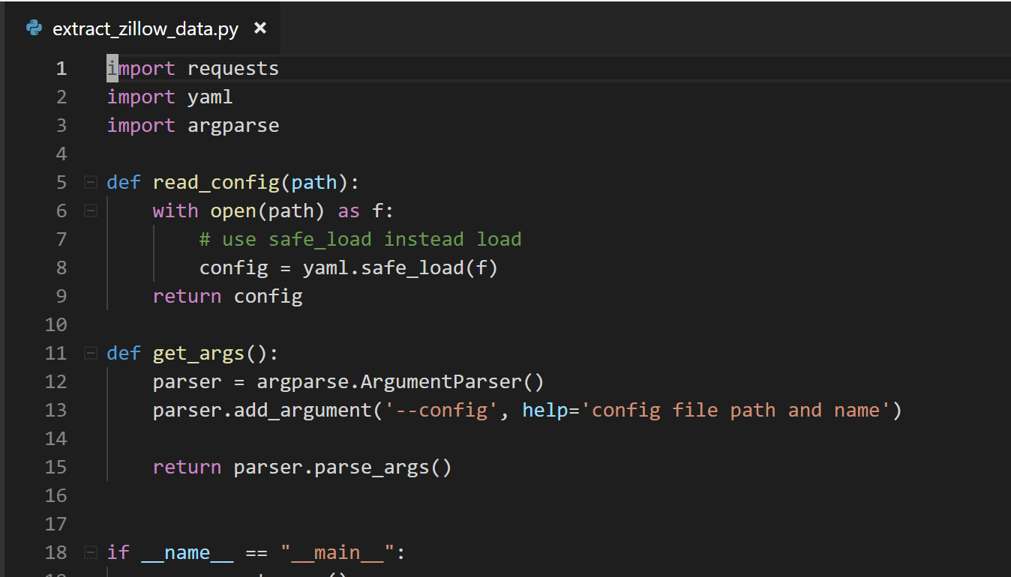
DATA COLLECTION & PREPARATION
Python to automatically pull data from Zillow and the Census Bureau API
Save csv files as an intermediate result
YAML to configure the data we download
With pandas we reshaped the data to a useful format
With crontab we can pull these data sets monthly
11
University of Chicago MScA JUNE 2019

Slide 12
DATA PROCESSING
How did we combine datasets?
Formatted the pivoted datasets to unpivoted to fit the MySQL schema, and normalized them to avoid redundancies.
Omitted null records and negative values ( price, age, population etc.) and did our best to fill null value by calculations.
Grouped and combined different datasets by zip codes and time frames.
Moved data from the operational database to the analytical data warehouse using SQL scripts
Transformed monthly dataset into yearly, and kept both in the dimensional model to have flexibility creating reports.
Generated MySQL Views for analytical purposes – occupancy rate, population growth etc .
12
University of Chicago MScA JUNE 2019

Slide 13
DESIGN AND PLATFORM CONSIDERATIONS
Used relational data structures over NoSQL data stores
The data we are considering is inherently relational in nature
The cost of this choice is in the lack of flexibility of schema and the support cost of adding new fields
Both operational and analytical databases are in MySQL in GCP
Makes them easily available
Reduces overhead in on prem maintenance
Using Star Schema in the analytical database
This allows for faster, less complicated ad hoc querying of the data set centered around the specific facts we are interested in
13
University of Chicago MScA JUNE 2019

Slide 14
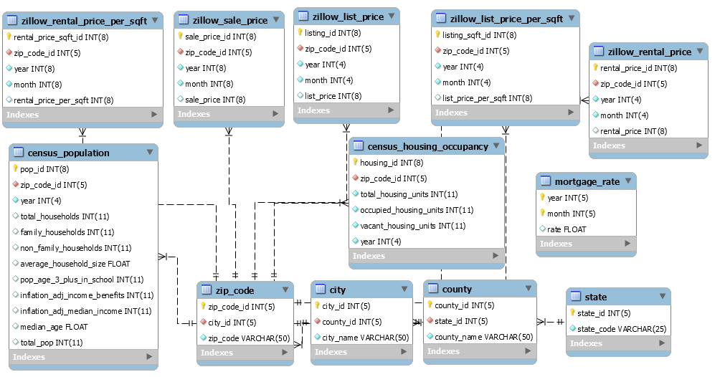
EER DIAGRAM
14
University of Chicago MScA JUNE 2019

Slide 15
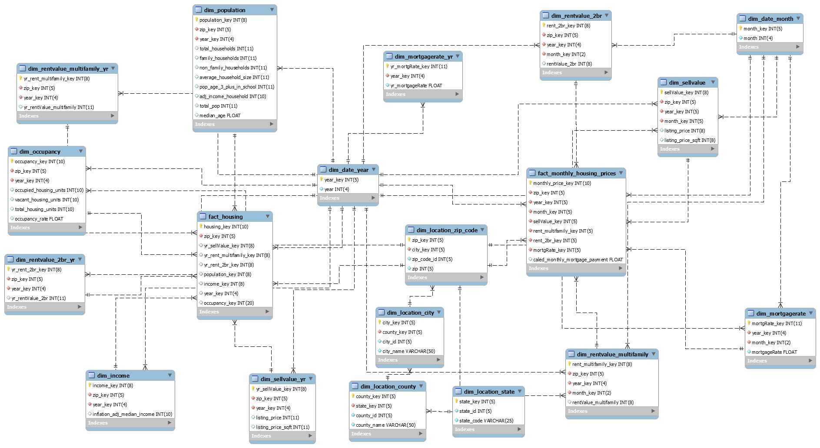
DIMENSIONAL MODEL
15
University of Chicago MScA JUNE 2019

Slide 16

REPORTING

Slide 17
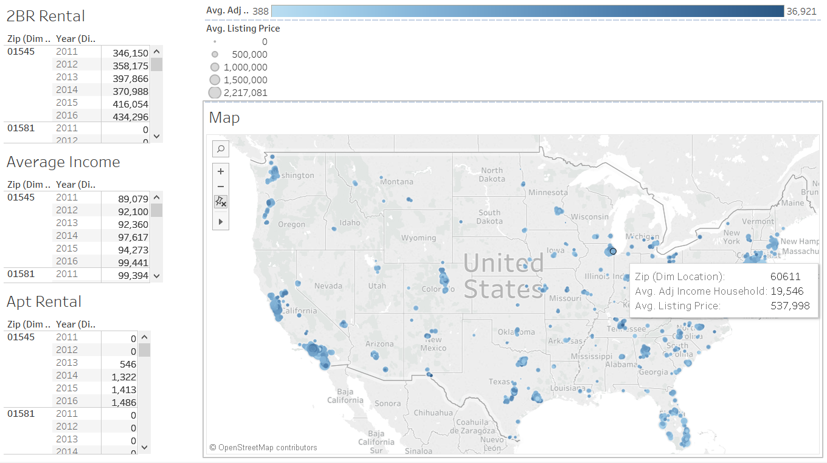
DETAILS OF RENTAL PRICE AND INCOME
17
University of Chicago MScA JUNE 2019

Slide 18
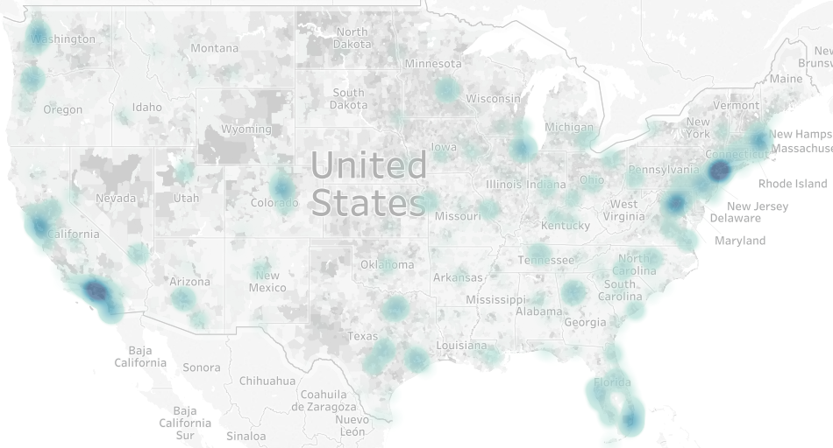
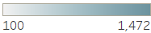
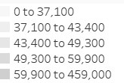
Listing Price/ sq ft
Household Effective Buying Power
Customer can utilize the dashboards to find nice neighborhood.
Business owners can have a generic view of locations with high growing potentials. They can identify target audiences by finding locations with lower listing prices or rent but with customers with relative high effective buying power.
LIST PRICE/SQ FT AND
EFFECTIVE BUYING POWER
18

Slide 19
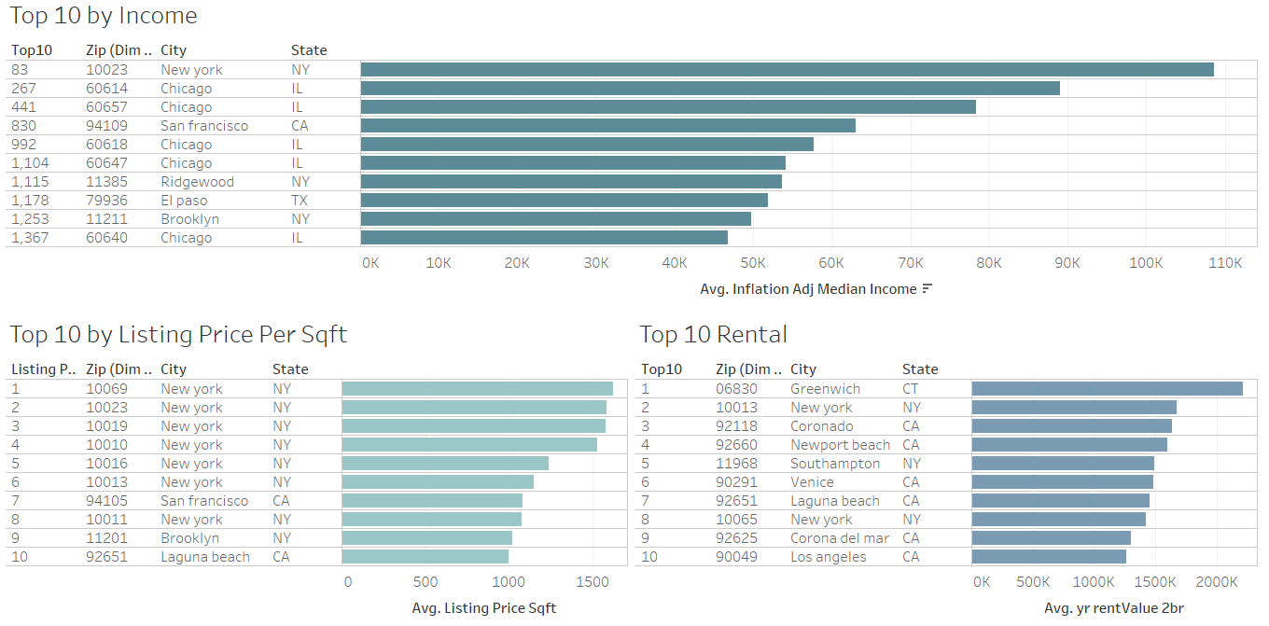
The dashboard can be filtered by state, city, and zip code to have clear picture of each location.
TOP 10 DASHBOARD

Slide 20
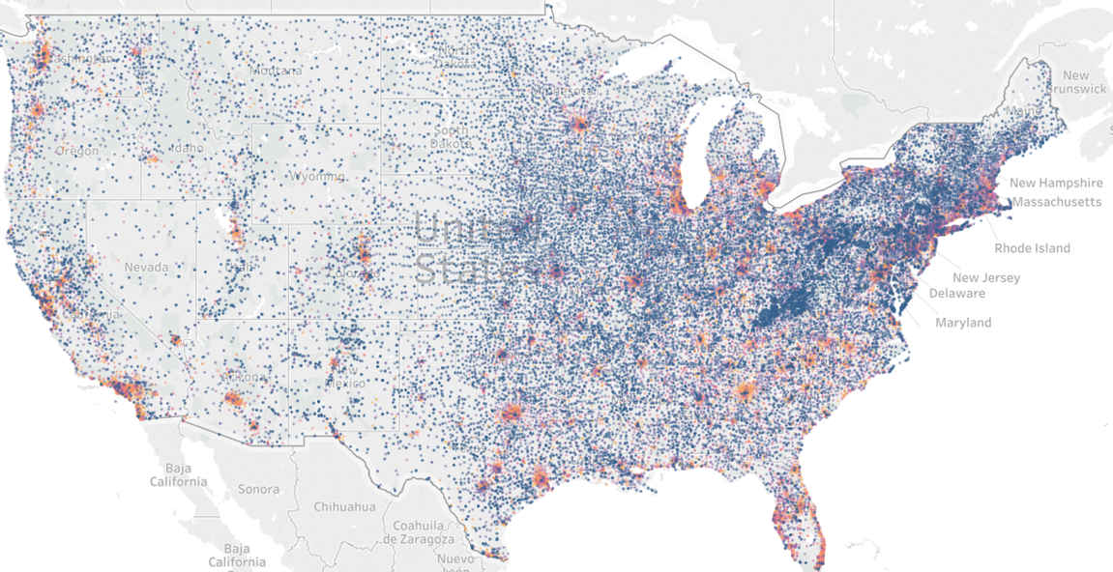
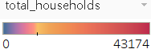
HOUSEHOLD
DENSITY
20
University of Chicago MScA JUNE 2019

Slide 21
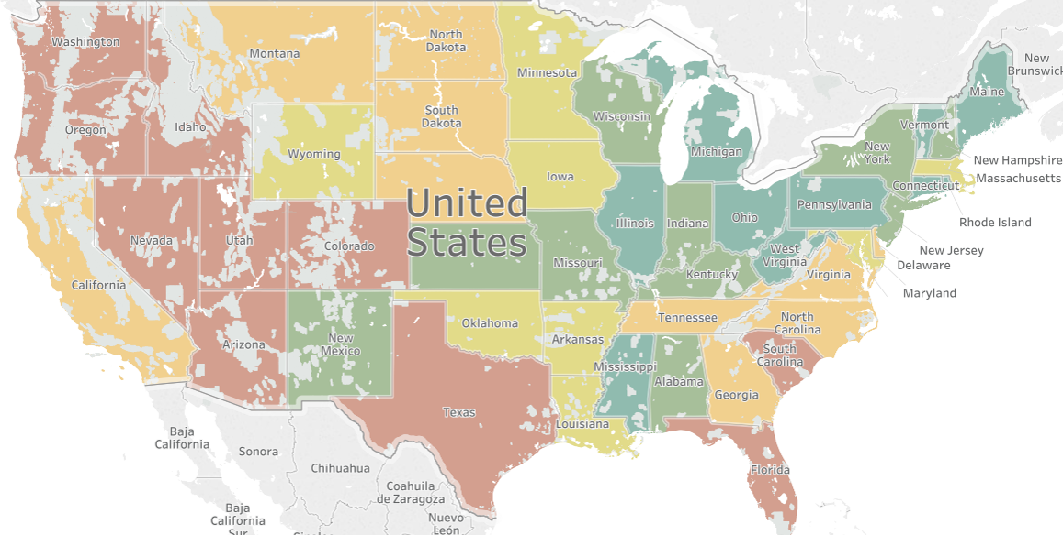
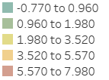
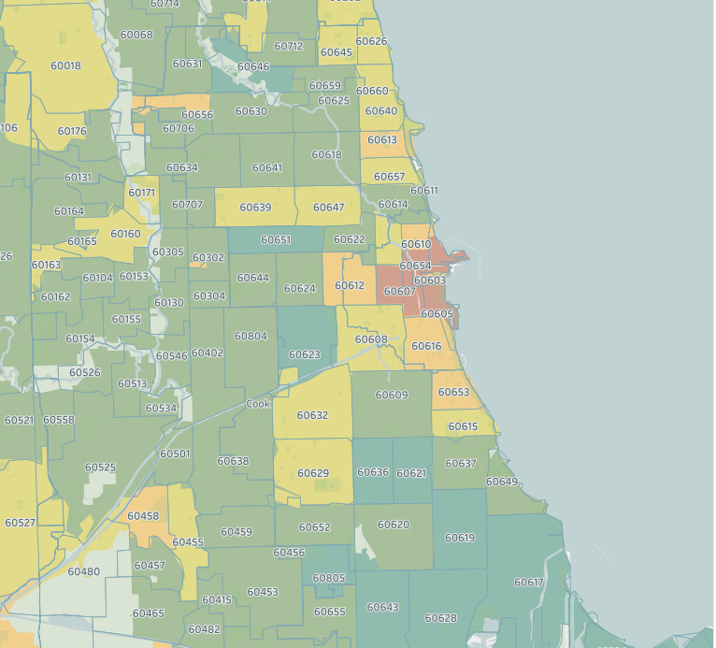
Population growth rate
CHICAGO
POPULATION GROWTH
21
University of Chicago MScA JUNE 2019

Slide 22
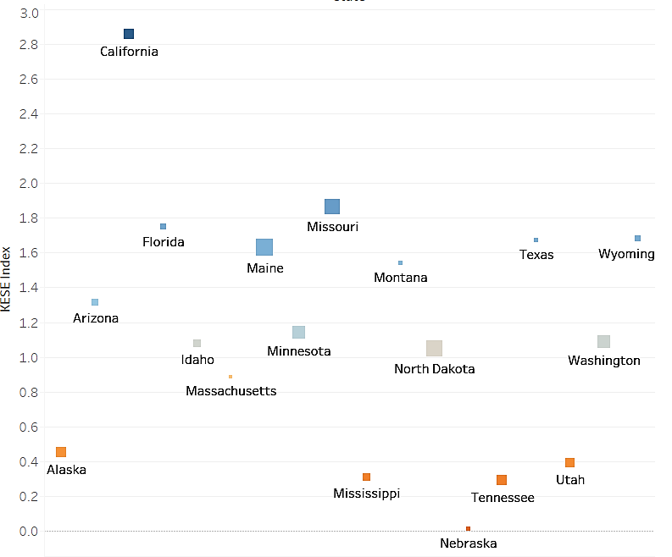
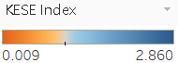
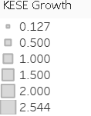
FASTEST GROWING POPULATION
JOB CREATION
IDAHO
KESE: the level of entrepreneur activities.
These states attract migration due to their growing economies.
2.1%
NEVADA
1.9%
UTAH
1.8%
WASHINGTON
1.7%
FLORIDA
1.5%
ARIZONA
1.5%
TEXAS
1.4%
1.0%
1.5%
2.0%
22

Slide 23
WHAT ATTRACTS MIGRATION?
19.4%
18.4%
22.6%
27.9%
LIVING EXPENSE
LIVING CONDITION
FAMILY
EMPLOYMENT/EDUCATION
Cheaper housing
Lower taxes
Lower household expenses
Own their home instead of rent
Lower crime rate
Climate
Relocate to a better home
Commercial/ residential/ agricultural & forestry
Neighborhood : race, religion , society status
Establish their own household
Change in marital status
Other family reasons
New job or job transfer
Closer to work or have an easier commute
Attend college
Retired
11.7% OTHERS
Data: Census CPS Historical Migration
University of Chicago MScA JUNE 2019

Slide 24
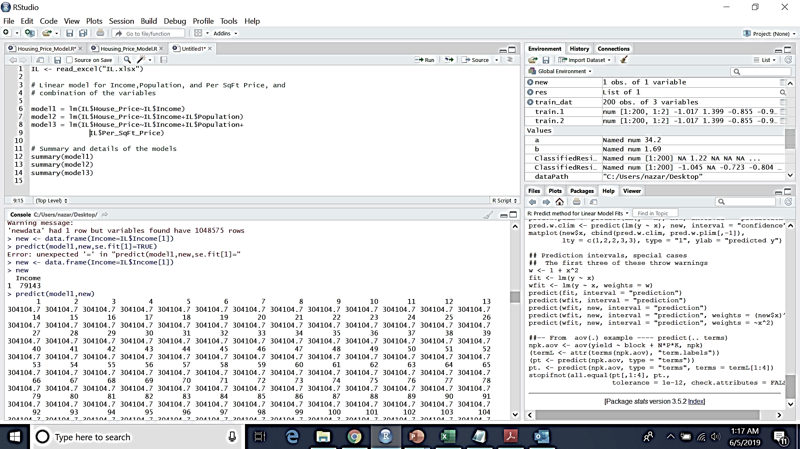
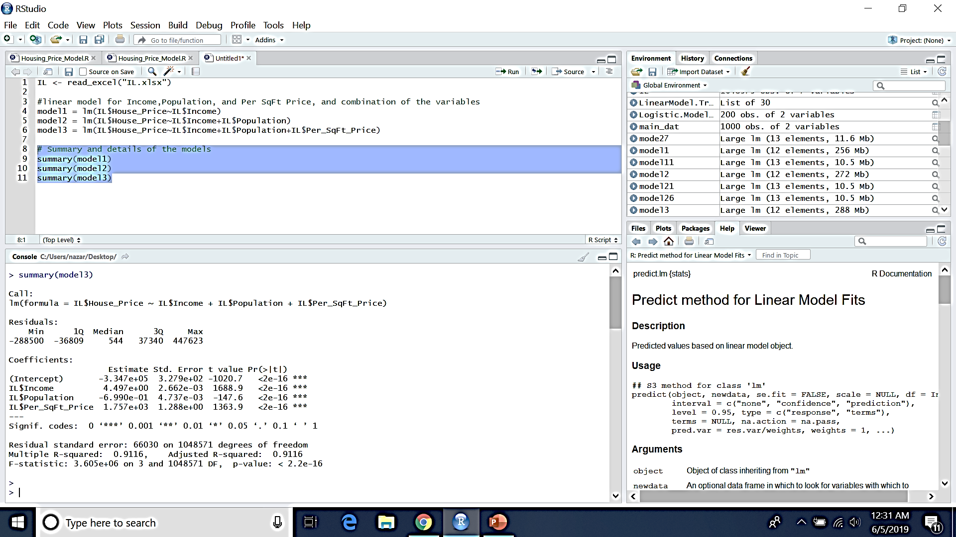
PREDICTIVE MODEL
CODE
MODEL
Linear Regression Model
VARIABLES
Median Income
Population
Median Rental Price (per sqft )
EQUATION
OUTPUT
Real Estate Price = 4.5 * Income - 0.7 * Population + 1757 * Price per sqft - 334700
FINAL PREDICTION
ZIP | City | State | Population
60015 | Deerfield | IL | 26,905
Income | Price/sqft | House price | Est. Price
$ 126,943 | $ 227.56 | $ 572,000 | $ 617,533
Accuracy
92%
24
University of Chicago MScA JUNE 2019

Slide 25
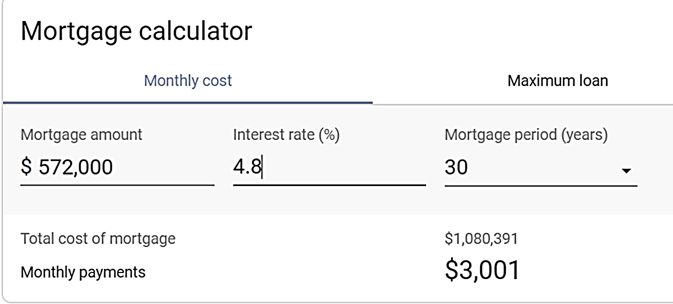


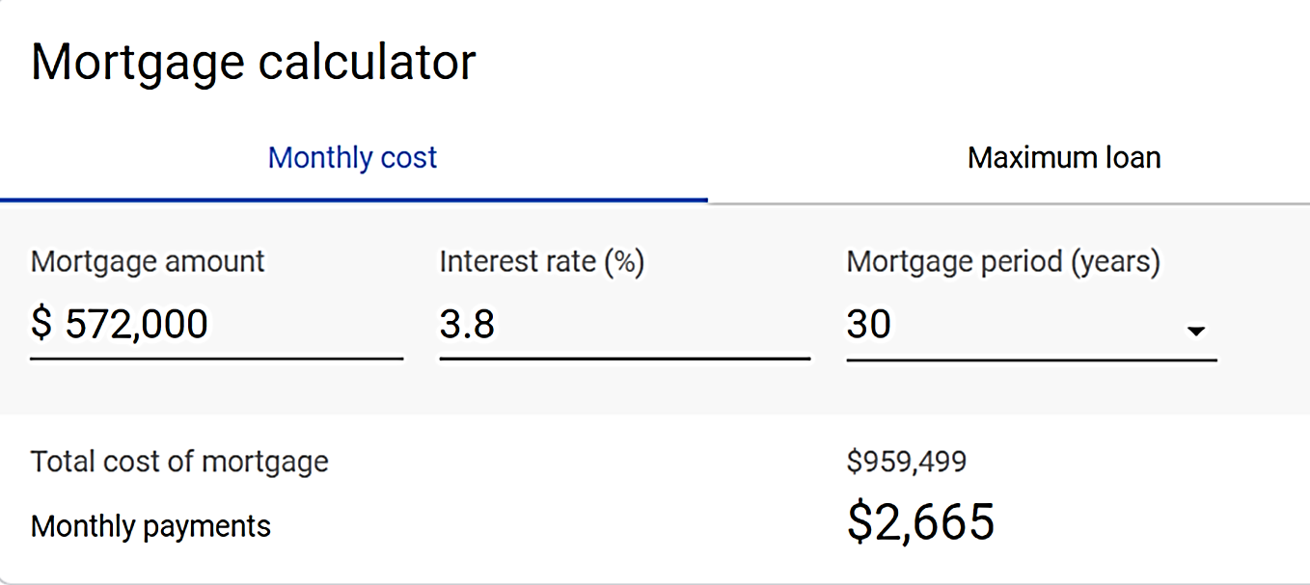
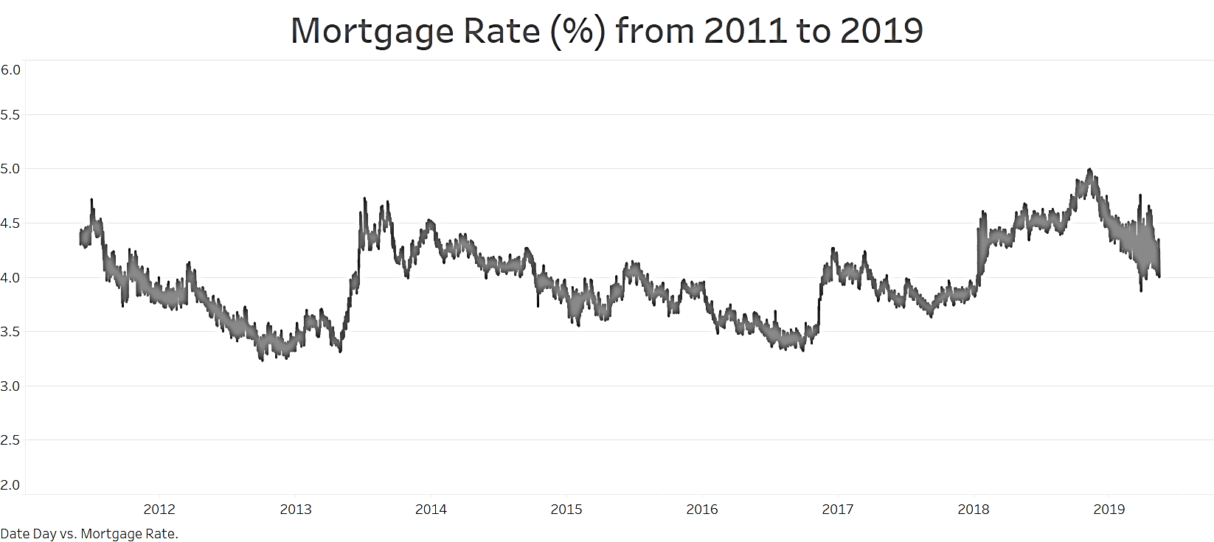
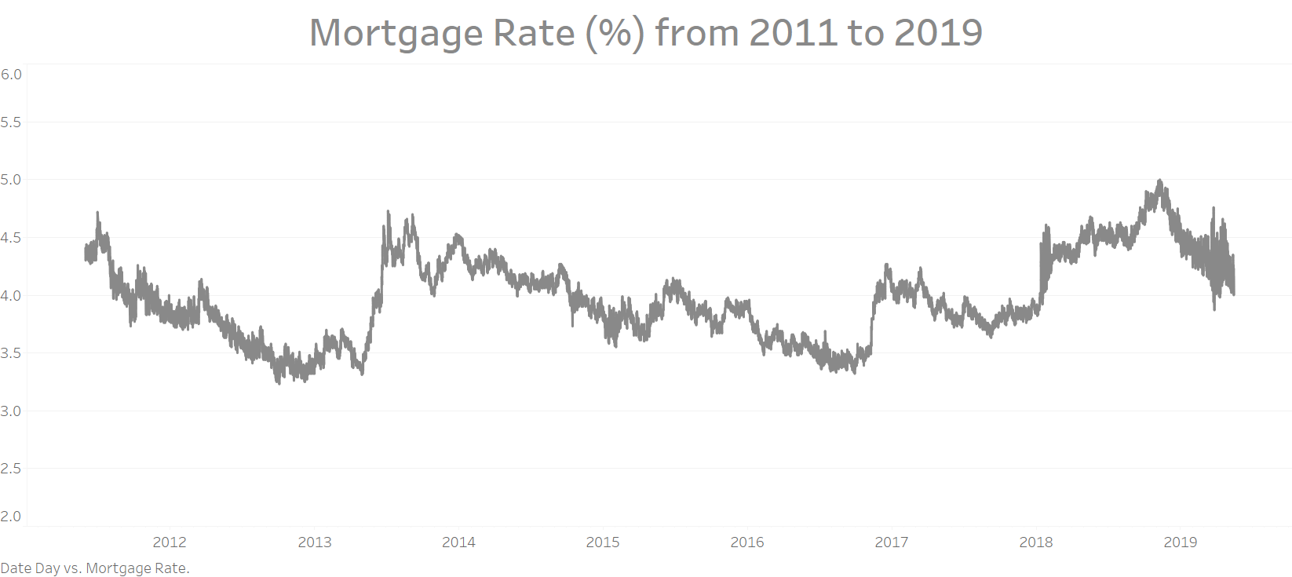
`
MORTGAGE RATE ON
REAL ESTATE PRICING
SCENARIO 1
Mortgage rate 4.8%
Mar. 2019
Negative correlation Between real estate prices and mortgage rates.
Higher mortgage rates put downward pressure on home prices, lower rates artificially inflate property values.
SCENARIO 2
Mortgage rate 3.8%
Apr. 2019
Highest mortgage rate in 2019 is 4.8%
Difference of total cost of mortgage $120,892
Lowest mortgage rate in 2019 is 3.8%
DON’T make a deal on a house when mortgage rate are HIGH.
25
University of Chicago MScA JUNE 2019

Slide 26
CHALLENGES, CONCLUSIONS, AND RECOMMENDATIONS

Slide 27
CHALLENGES
Exporting large data from MySQL to R was a problem because of limited memory capacity
Narrow down the dependent variables for predictive analytics.
Managing Zillow data that is extracted in a non-useful shape
Finding the appropriate data sets in the Census API.
There are literally thousands of possible columns, most of which are not interesting for our use case
Different locations and time frames
Missing value from some locations from different data sources
27
University of Chicago MScA JUNE 2019

Slide 28
CONCLUSIONS & RECOMMENDATIONS
This data set does provide useful insights into real estate values and reasonable predictive power
There are many more data sets out there that could be useful to add to increase the power of this insight:
More census data like commute time and income disparity metrics
Crime data
Economic information
Climate data
There is more analysis to be done on the trends in this data, including how valuable is momentum in housing markets
28
University of Chicago MScA JUNE 2019

Slide 29
LESSONS LEARNED
Uploading data straight from CSV files using Python is much faster than using MySQL Workbench import wizard
ETL and the beginning portion of the data pipeline was the most time consuming part
It helps to have good data before you start analyzing it
Define goals more specifically up front
29
University of Chicago MScA JUNE 2019

Slide 30
REFERENCES
Zillow Research Data
https://www.zillow.com/research/data/
US Census American Community Survey 5 Year Data
https://www.census.gov/data/developers/data-sets/acs-5year.html
Data.gov FIPS
https://catalog.data.gov/dataset?tags=fips
KESE Index
https://indicators.kauffman.org/
30
University of Chicago MScA JUNE 2019

Slide 31
Thank you!
Any questions?
31
University of Chicago MScA JUNE 2019

